Slide 1


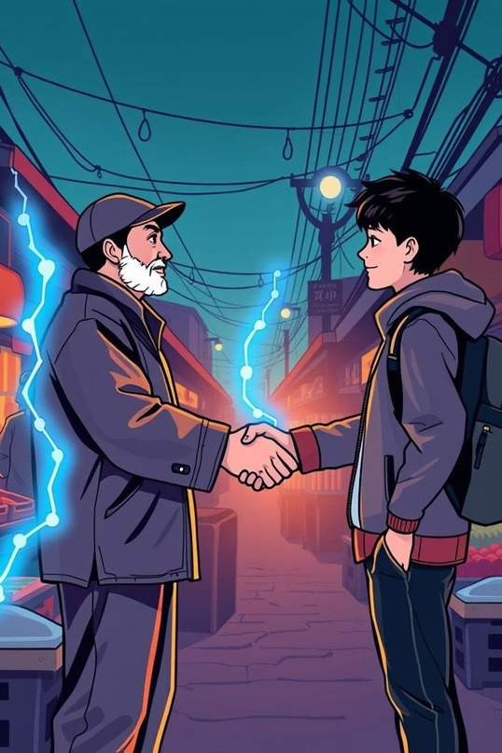
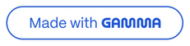
Bro-Chain...
The Integrated Super-App for Local Vendors as well as upcoming enterpreneurs..
Empowering Vendors & Young Minds Together

Slide 2



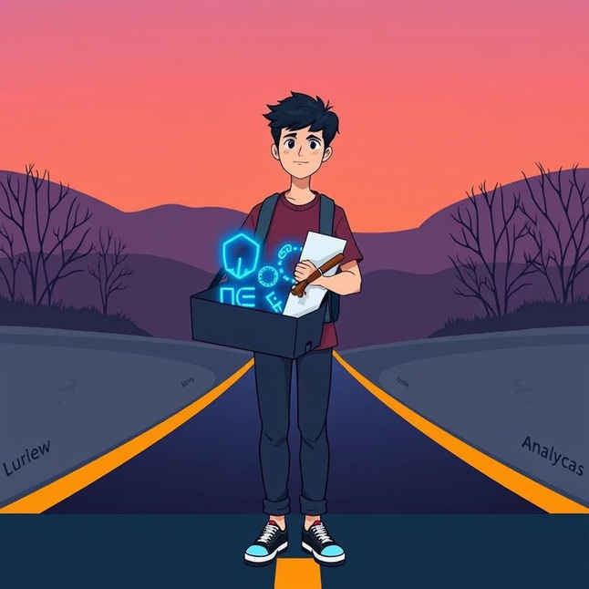
The Problem: Disconnected Ecosystems
Vendors: Digital Isolation
Youth: Untapped Potential
Limite
d access to modern digital tools.
Posse ss valuable digital skills but lack real-world application.
Fragmented solutions that don't integrate. Struggling to compete in a digital-first economy.

Slide 3
Bro-Chain... : Bridging the Divide
Weintroduce BroChain,arevolutionaryintegratedsuper-appdesignedtoconnectand empower local
vendors and talented Youth
1
2
3
Vendor Needs
Bro-Chain... Super-App
Freelancers Skills
Efficient payments, targeted marketing, insightful analytics.
A unified platform offering comprehensive tools and a vibrant marketplace
Graphic design, social media, data analysis, IT support.
BroChain creates a symbiotic relationship where vendors gain digital capabilities and youth gain valuable experience and income.

Slide 4



Why Integration is Our Unique Selling Proposition?
For Vendors
For Youth
No more juggling disparate apps. Bro-Chain... provides a single, intuitive interface for payments, marketing, inventory, and customer management. This simplifies operations and boosts efficiency.
Beyond scattered freelance gigs, Bro-Chain offers a direct, curated marketplace within the app, connecting them directly to local business needs and fostering skill development in real-world contexts.

Slide 5
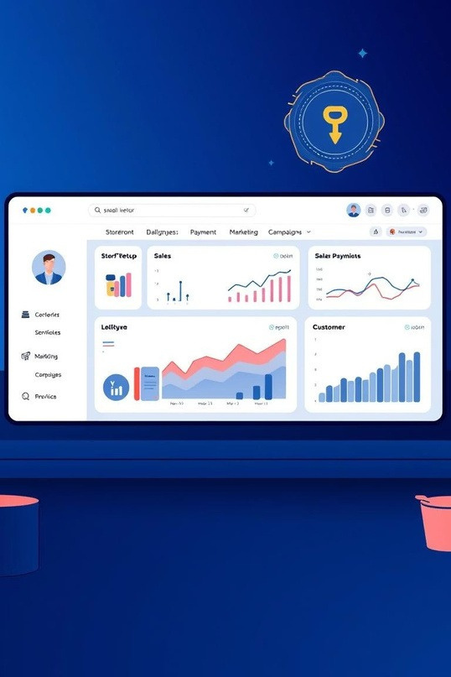
Vendor Features: Supercharging Small Businesses
Digital Store front Setup :Easy creation of online presence. Seamless Digital Payments: Integrated payment gateway with blockchain ledger for transparent, secure transactions.
Advanced Analytics: Real-time expense and sales tracking. Marketing Campaigns: Tools for customer engagement and
promotions.
Customer Connect: Direct communication channels to build
loyalty.

Slide 6
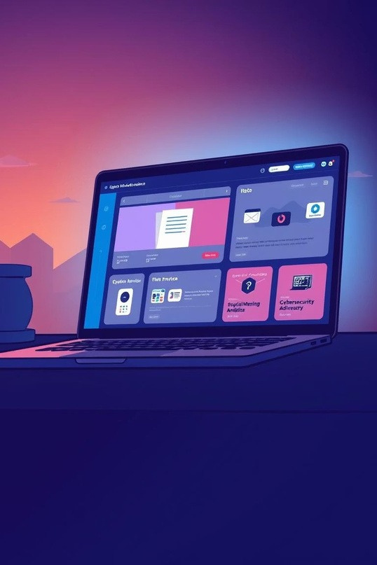
Youth Features: Launching Careers
DigitalServices Marketplace:Offer skillsindesign,marketing, analytics, and IT supportdirectlyto vendors.
Real Business Case Studies: Work on live projects, gaining invaluable
hands-on experience.
Certified Portfolio Building: Automatic certification and portfolio
showcasing successful projects completed through BroChain.
Peer-to-Peer Collaboration: Connect with other young talent.

Slide 7
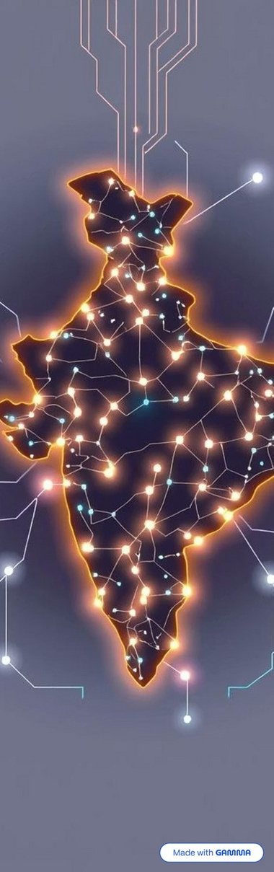

A Cycle of Mutual Growth
Vendor Empowers
Vendors embrace digital tools, improving efficiency and reach.
Youth Engages
Students apply digital skills, providing services and gaining experience.
Revenue & Growth
Vendors see increased sales and market presence.
Income & Experience
Youth earn income, build portfolios, and enhance their resumes.
Local Economy Boost
Combined success stimulates local commerce and job creation, creating a virtuous cycle.

Slide 8

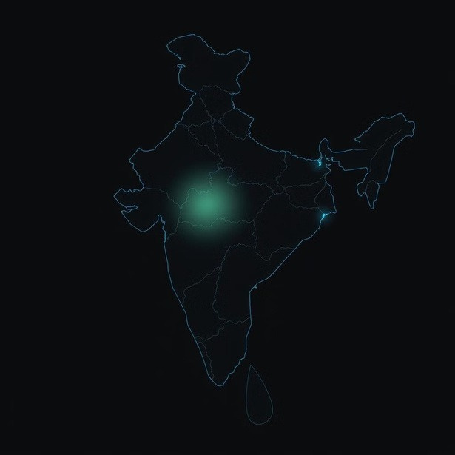
Massive Market Opportunity in India
Vendor s: 49 M+ registered street vendors across India.
Youth: ~young millennials entering the workforce, digitally native and seeking opportunities.
BroChain uniquely bridges these two vast, underserved markets, unlocking immense value and fostering economic inclusion at scale.

Slide 9
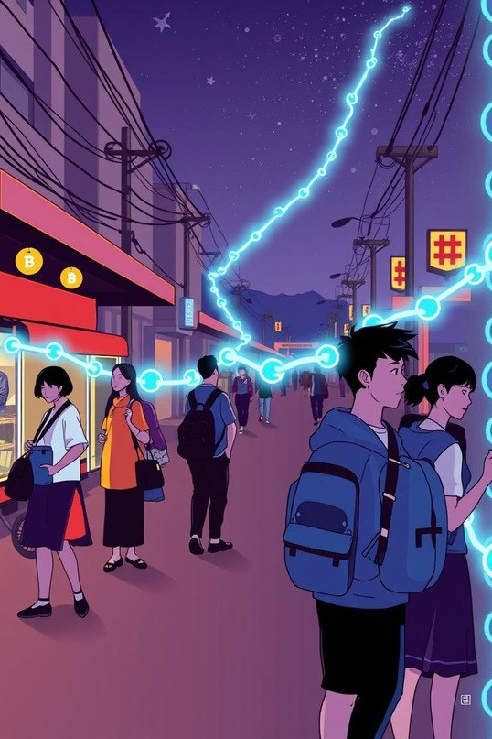
BRO-Chain.. Tech Stack
Frontend (User Interface)
Built with HTML,CSS and JS & React Native Simple, mobile-first design Dashboards for sales, payments, and marketing
Backend (Business Logic)
Powered by Node.js, Express.js & MongoDB Manages vendor data, ana lytics, and campaigns APIs connect frontend and blockchain seamlessly
Blockchain (T
rust Layer)
Solidity Smart Contracts, Hardhat, MetaMask immutable transaction ledger & secure payments Transparent vendor–student collaborations

Slide 10
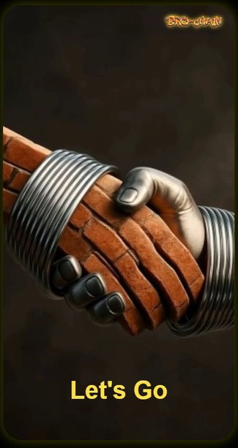
USER INTERFACE & EXPERIENCE
Introducing BRO-Chain… - where Trust Meets Technology

Slide 11
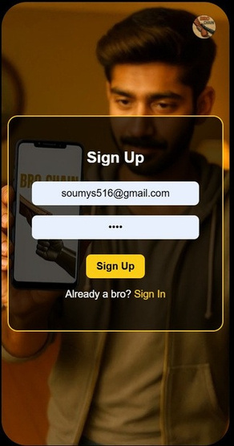
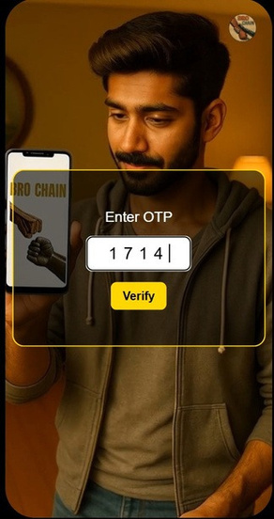
USER INTERFACE & EXPERIENCE
"Signing up on BroChain? Couldn’t be easier — just your email, password, a quick OTP… and you’re in!"

Slide 12
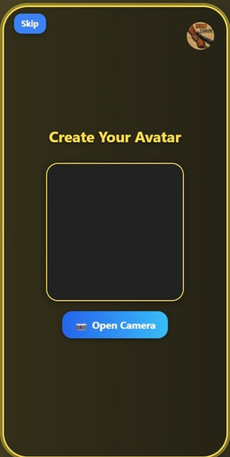
USER INTERFACE & EXPERIENCE
"And if you want, you can even create your own avatar right away — or skip it and do it later."

Slide 13
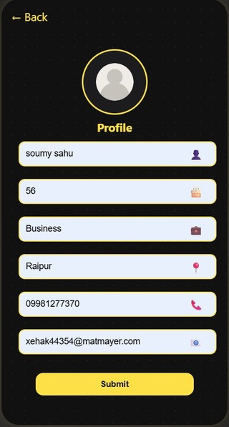
USER INTERFACE & EXPERIENCE
"Next, set up your profile — name, age, profession, location, phone, email — and boom, your account is ready." Just the essentials, nothing unnecessary

Slide 14
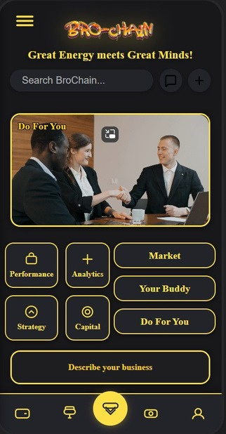
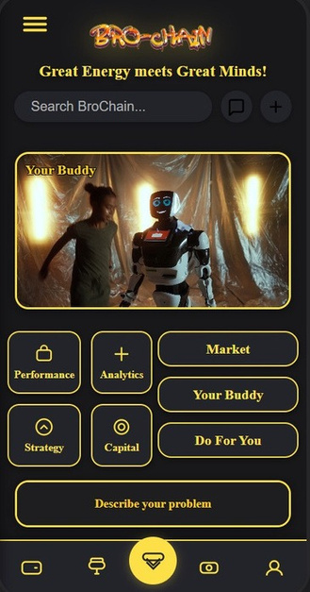
USER INTERFACE & EXPERIENCE
"Now, welcome to the home page — your command center. Right infront of you we offer DO FOR YOU& Your Buddy,

Slide 15
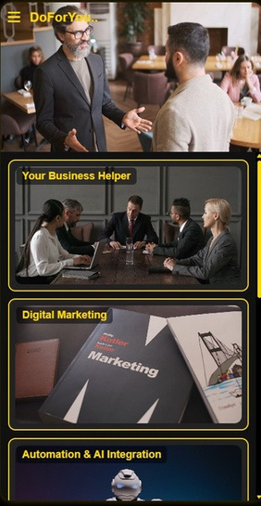
USER INTERFACE & EXPERIENCE
Do For You — where BroChain analyses your needs and gives you the exact solution, including specialized services.” Powered by AI and blockchain, your answers are personalised and secure.

Slide 16
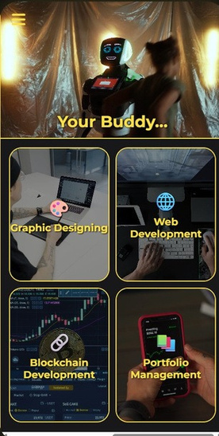
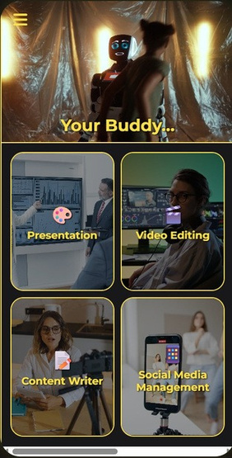
USER INTERFACE & EXPERIENCE
"And then there’s Your Buddy — packed with services for individuals and budding entrepreneurs." It’s like having a smart assistant in your pocket.

Slide 17
THANK YOU

